Slide 1
Community Voices Council

Slide 2






BHT Vision
In our region every person, regardless of environment, background, or life experiences, will live a productive, high quality life by ensuring access to:
An integrated whole person health care system.
Stable housing, nutritious food, and transportation.
Opportunity for education and training that allows for meaningful employment that pays the bills with some left over for savings.
Social support networks that allow for emotional, social and psychological wellbeing.

Slide 3
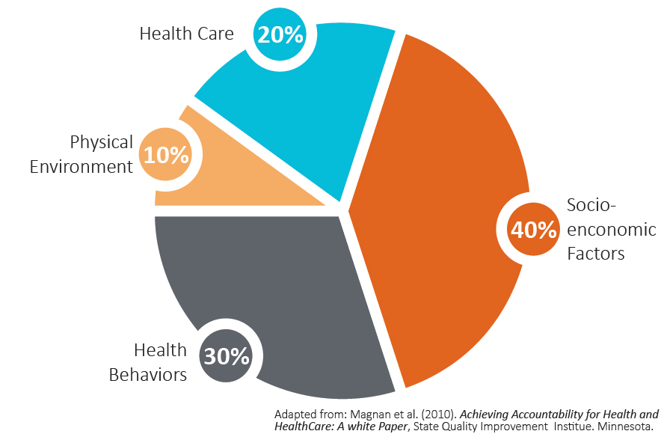
Social Determinants of Health

Slide 4
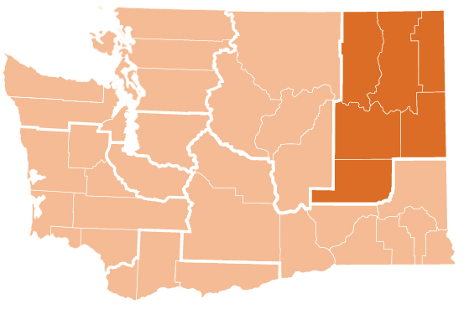


Better Health Together
Accountable Community of Health (ACH): Leading our region’s efforts to create a robust and impactful Accountable Community of Health (ACH), engaging with via 6 Community Health Transformation Collaboratives, comprised of the key settings needed to make transformational change to the Medicaid delivery system.
Navigator Network: Coordinating efforts to ensure access to health insurance. Since 2013, BHT has led the Navigator Network that dramatically decreased the uninsured rate in our region to a generational low.

Slide 5

Who is “in” the County Based Collaborative?
Hospitals & ER
EMS/FIRE/POLICE
Primary Care
Mental Health & SUD
Social Support Services:
Special Population & Chronic Disease
Collaborative
Roundtable
Oral
Native Health Providers
MCOs
(Not eligible for Waiver $)
Pharmacy
Public Health
Social Determinants
of Health
Food, Housing, Transportation
Notes:
Main messages:
Participants from all settings to create the networks needed for systemic change.
Phase 1 of planning has primary care and behavioral health settings submitting plans. We would expect that all other Partnering Providers would be involved via strategic, value-added partnerships.

Slide 6
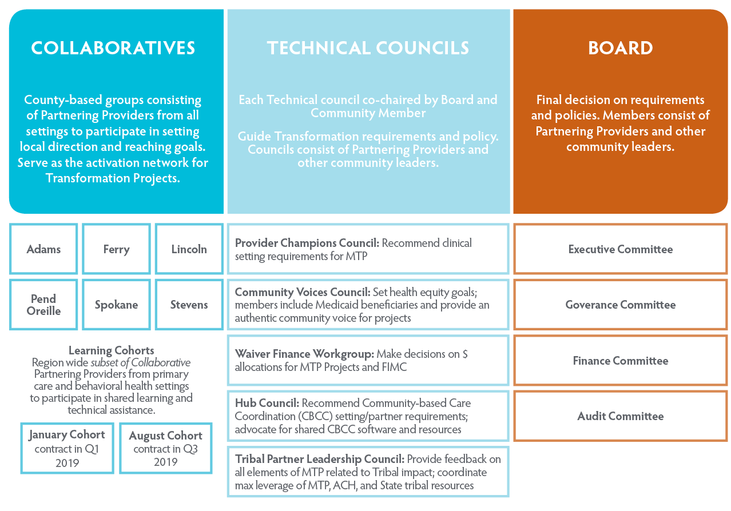
Overview
Working Groups
Advisory Groups
Governing Group

Slide 7
Community Voices Council Vision
The Community Voices Council believes no one in the BHT region should experience a difference in access to care as a result of their identity, income, or ability.
To support this vision, we would like to see:
Access to a variety of available options for health care and social service providers when we are seeking care.
Clear and transparent information about the choices available to us when seeking care.
Easy to access, trusted support available to support us when we need extra help navigating services.

Slide 8
How We Work
The CVC makes recommendations to the BHT board and health care leaders on improvements that will support our vision. Some of the things we’d like to work on include:
Developing a standard definition for case management activities
Promoting collaboration between social services and health care services
Promoting transparency in health care by giving recommendations on communications and education opportunities
Giving recommendations to health care leaders on how to improve community resources and services
Representing community voice to health care leaders

Slide 9
Who are we looking for?
You are currently on Medicaid (Apple Health)
You want to be an active part of making your community healthier
You have first-hand experience accessing health care or social services, and are comfortable sharing those experiences with others
You like to talk to people in your community about what issues are affecting them
You like to come up with ideas for solutions that help your community and neighbors

Slide 10
Expectations
We ask for 4-8 hours of time a month from our Community Voices Council Members. Expectations include:
Attend monthly Community Voices Council Meeting (in person in Spokane or via phone/computer). Engage with community groups regularly, and bring back information and questions to the monthly council meetings
Attend other BHT and Community Meetings on occasion
Attend and complete required trainings after hire, such as Leadership Training and Community Health Worker training (paid for by BHT)

Slide 11
Questions?

