Slide 1
Spokane Collaborative
Sept 19, 2019

Slide 2
Updates from BHT
Notes:
Sarah, Charisse, Hadley

Slide 3
Equity Assessment is Live!
Earn dollars and help your organization along an equity journey by taking assessment and setting internal goal from results
Required for Contracted Partners, $15,000 incentive for non-contracted partners
All staff need to take!
Average completion time is 13 minutes
Surveymonkey.com/r/BHTEQA

Slide 4
Refresher – why are we doing this work?
Testing an innovative, collaborative process for collective impact
Focusing on equity
Accountability for results, cause trying hard is not good enough.
But, not easy. Not punitive!

Slide 5
Where are we at?
Results
Population Indictors
Strategies
Strategy Measures
Commit
Hone in on inequities
Activity Planning
Work begins
Budgeting
Review the 3 community results
Define the changes needed and results desired more specifically with available data
Are there subpopulations experiencing worse results than other? Which groups are experiencing the worse results? Where is the priority for action?
From all possible strategies, prioritize strategies for this improvement cycle.
Develop ways to measure those strategies to monitor progress while practicing
Who will do what? What’s needed? Who can help/partner?
How much funds do we have? How much to each strategy?
Project submitted and selected. Organizations commit (Oct - Nov)
2020

Slide 6
Managing Expectations
Not perfectly linear
Everyone can contribute to ideas about “what works”
Subject matter experts
Outside-in perspective
Plan might will evolve
Community mobilization work is just plain hard, and messy
Notes:
Remember, data don’t make decisions, you do.

Slide 7
Spokane Collaborative Priorities
Child Abuse and Neglect
Behavioral Health
Affordable Housing
Notes:
Refer participants to handout

Slide 8
Speed Dating Exercise Stats
45 speed dating cards submitted
48 ‘matches’ identified
59 activities proposed by 39 different organizations/ programs
94 resources offered
40 needs identified

Slide 9
Speed Dating Cards

Slide 10
Speed Dating Cards

Slide 11
Speed Dating Cards

Slide 12
Speed Dating Cards

Slide 13
Speed Dating Cards Use
Don’t get discouraged if no matches!
Reflect on activities you proposed
Connect with organizations you are interested in working with or those who are interested in working with you
Collaborate and solve all the problems!

Slide 14
Introduction to Participatory Budgeting
What is PB?
Participatory Budgeting is a democratic process in which community members directly decide how to spend part of a public budget. It is a way to manage public money that enables community members to collaborate in making budget decisions that affect their everyday lives.
https://vimeo.com/162743651
Notes:
O – what do you think about this concept?
R – have you experienced anything similar during your career?
I – how do you think this could be a useful tool for the Spokane Collaborative?

Slide 15
Participatory Budgeting Principles
DIVERSITY OF PARTICIPANTS
DIRECT INVOLVEMENT
TRANSPARENCY
EMPOWERMENT
ACCESSIBILIY
SHARED RESPONSBILITY

Slide 16
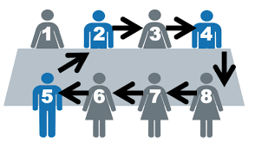
Group Breakout Session: Instructions
Networking. Review your dating card and connect with your matches.
Where is their opportunity for collaborative work?
Can you reach agreement/commitment to move forward?
Will you consider a joint application for equity project dollars?
What support is needed from BHT?
Discuss the strategies with one another. Does it make sense? Will it have an impact? Is it equity forward?
Notes:
We will be allocating at the strategy level
Each participant will get $100 in 10’s to allocate
Participants can spend up to (but not more than) 50% in their home strategy. They are not required to spend anything in their home strategy if they don’t want to.
We are going to exclude strategies that did not get interest from the individual activity proposals nor in the speed dating. So the strategy list will be:
Policy/Systems/Structure Holdback Bucket (need a clever name for this)
Behavioral Health (BH)
Reduce stigma and encourage people to get care by public education
Build community in neighborhoods to reduce isolation and support mental wellness
Increase screening and education/resources for SDOH in behavioral health and primary care and community setting
Child Abuse & Neglect (CN)
Increase and diversify community and home-based parent training and support in selected zip codes
Increase knowledge and professional training around ACEs for parents, students, and professionals
Build community based hubs of resources and safe spaces
Affordable Housing (AH)
Reduce/ subsidize/ limit housing entry fees
Improve community engagement to break down misconceptions and barriers
Expand community transit options
Reassess and recommend zoning/ density/ subsidy policies to increase affordable options for all
We want to do some facilitation/guidance before we set them loose, encouraging folks to look at strategies in other areas that will help leverage their work, how does investment in other sectors support my work, etc.)

Slide 17
Today’s Work
https://www.youtube.com/watch?v=gOa1fK5USXk

Slide 18
Group Breakout Session
Budgeting. Select the STRATEGY you most want to contribute to (i.e. within your “home” priority.
Up to but no more than 50% of your budget in your preferred strategy in your home priority.
You don’t have to spend the money in your preferred strategy.
You may allocate the initial 50% across multiple strategies within the home priority.
Place your allocation in the appropriate strategy bucket.
Notes:
Notes for facilitators:
Time: NO MORE THAN 10 MINUTES FOR THE TRANSITION.
Need data for each indicator if possible, in a handout.
Need poster sheets, one sheet per each question of turn-the-curve – 6 total.
Participants to self-select to result most interested in.
Indicator 1 – facilitated by Jen Hansen
Indicator 2– facilitated by Rowena Pineda
Indicator 3 – facilitated by Steve Smith?
Indicator 4 – facilitated by Jene Ray

Slide 19
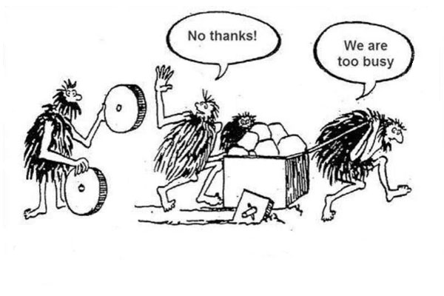
Group Breakout Session
Tip: If you can’t think beyond your horizon you just might miss a breakthrough.
Budgeting Part 2. Now…visit the other strategies and allocate the remaining 50% of your budget as you see fit.
You CANNOT fund your original strategy again.
Fund other strategies in other priorities, considering:
Leverage.
Impact.
Equity.
Notes:
Think about how strategies in other priorities may
Leverage your home strategy… are cross-cutting and could together strengthen community impact.
Likelihood of impacting equity

Slide 20
10 Strategies LEFT from initial planning
BEHAVIORAL HEALTH (BH) | CHILD ABUSE AND NEGLECT (CAN) | AFFORDABLE HOUSING (AH)
Reduce stigma and encourage people to get care by public education | Increase and diversify community and home-based parent training and support in selected zip codes | Reduce/ subsidize/ limit housing entry fees
Build community in neighborhoods to reduce isolation and support mental wellness | Increase knowledge and professional training around ACEs for parents, students, and professionals | Improve community engagement to break down misconceptions and barriers
Increase screening and education/resources for SDOH in behavioral health and primary care and community setting | Build community-based hubs of resources and safe space | Expand community transit options
 |  | Reassess and recommend zoning/ density/ subsidy policies to increase affordable options for all
Notes:
Note: two strategies were dropped because they received no interest from either the individual activity proposals submitted nor from the speed dating exercise.
Dropped:
BH
2. Co-locate service where people in need are
AH
2. Develop strategies to incentivize property owners to develop and rent unused space including vacant space and property

Slide 21
Bonus Strategy
A hold back bucket – emerging opportunities for policy change? system change? Environmental change? Participatory budget project?
How might we capitalize on opportunities to expand our impact with “upstream” initiatives that may emerge?
Notes:
CCT voted to have a “hold out” bucket for emerging policy and system change ideas and potentials… opportunities to have a large-scale impact on one or more of the priorities.

Slide 22
Next Steps
Sept
Oct
Nov
CCT met and designed parameters for Participatory Budgeting
Today! Participatory Budgeting
Spokane Collaborative decides how strategies will be funded
BHT staff collates funding allocations
BHT Board approves $
CCT finalizes budget and application/proposal process
Equity activities actually submitted
Dr. Goldberg in the house! Networking
CCT/workgroup – reviews proposals; funding decisions
Final projects communicated to Spokane Collaborate
Celebrate and get ready for 2020!
Notes:
Hadley

Slide 23
Reflections

